Slide 1
Connected Families, Connected Communities
Vision:
Connected families, connected communities – every child thrives!
Mission:
Kansas families have informed and equitable access to seamless, comprehensive supports and services that ensure the well-being and lifelong success of all.

Slide 2
Help Me Grow Kansas

Slide 3
Ensuring Every Child Thrives
Building on existing resources and connecting children and families to the services they need.
Encouraging collaborations across child health care, early care and education and family support.
Recognizing the unique strengths and traditions of each community and offering the freedom to implement HMG in a way that works for individual communities.

Slide 4
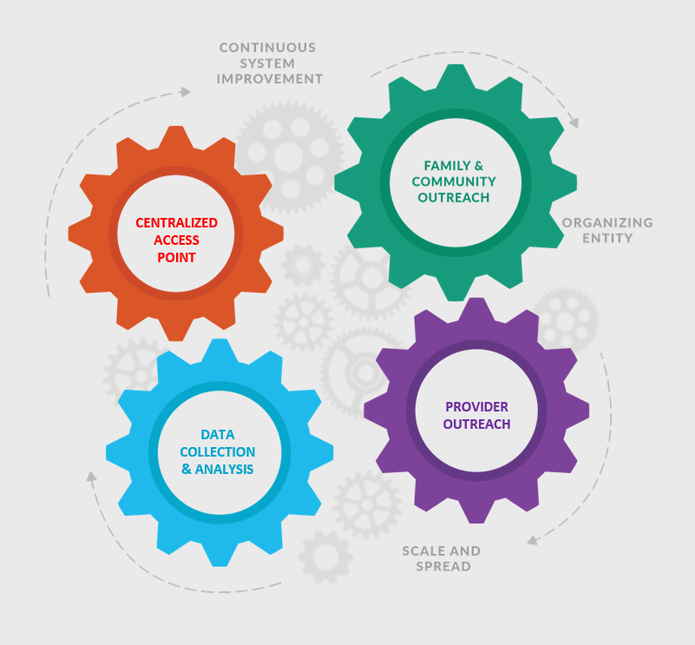
Help Me Grow
Core Components

Slide 5
Family & Community Outreach
Outreach & Engagement
Increase awareness of services available to families throughout communities
Guide education efforts around children’s developmental health

Slide 6
Provider Outreach
Identify provider champions
Provide training and education opportunities to providers
Advance rates of developmental surveillance and screening
Ensure providers are kept in the loop about referral outcomes and services received

Slide 7

Connecting Families
Integrated Referral & Intake System (IRIS)
A web-based communication tool designed to help organizations connect the families they serve to needed resources in their community
connectwithiris.org

Slide 8
Centralized Access Point
Information & Referral
Ensures families and providers have a “go-to” place to turn with questions about child development
Up-to-date resource directories enable providers to connect families to services and supports they need

Slide 9
Data Collection & Analysis
Guides quality improvement to ensure we are all growing and learning from this work
Supports evaluation
Helps identify systemic gaps
Bolsters advocacy efforts

Slide 10
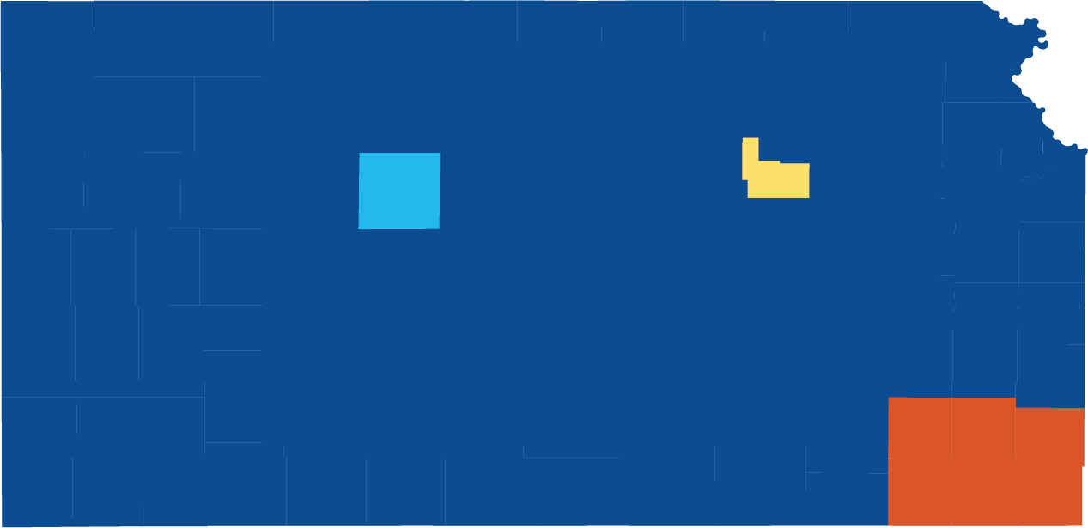
Initial Help Me Grow
Communities
Ellis County
Geary County
SE Kansas
Cherokee, Crawford, Labette, Montgomery,
Neosho, Wilson

Slide 11
Get Connected!
Help Me Grow Kansas Coordinators
Danielle Brower
Phone: 785-864-0402
Email: dbrower@ku.edu
Katie Hart
Phone: 314-440-7706
Email: katiehart@ku.edu
Rachel Gardner
Phone : 785-864-9775
Email: rachelgardner@ku.edu

